Slide 1
PORTAL FOR FARMERS

Slide 2
FLOW
Buyer Registration and Approval
Selection of Area to Buy Commodities
Price offered for Selected Commodities
Location
(Nearest Location to Buyer if possible)

Slide 3
INTERFACE (FARMERS)
TYPES OF INTERFACE:-
Works on smart phone(Android/Web based)
SMS to upload produce(offline)
Response via phone and SMS(offline)

Slide 4
INTEFACE FOR BUYERS
Portal (all updates will be received sent by various farmers)

Slide 5
TECHNOLOGY
Integration across systems
SMS
BOT computing (For queries)
Analysis and Data Science(Sales and produce graphs so that the farmer can come to know where the sales are high and where the sales are low)

Slide 6
Better and faster emergency care during accidents and vehicle impact.

Slide 7
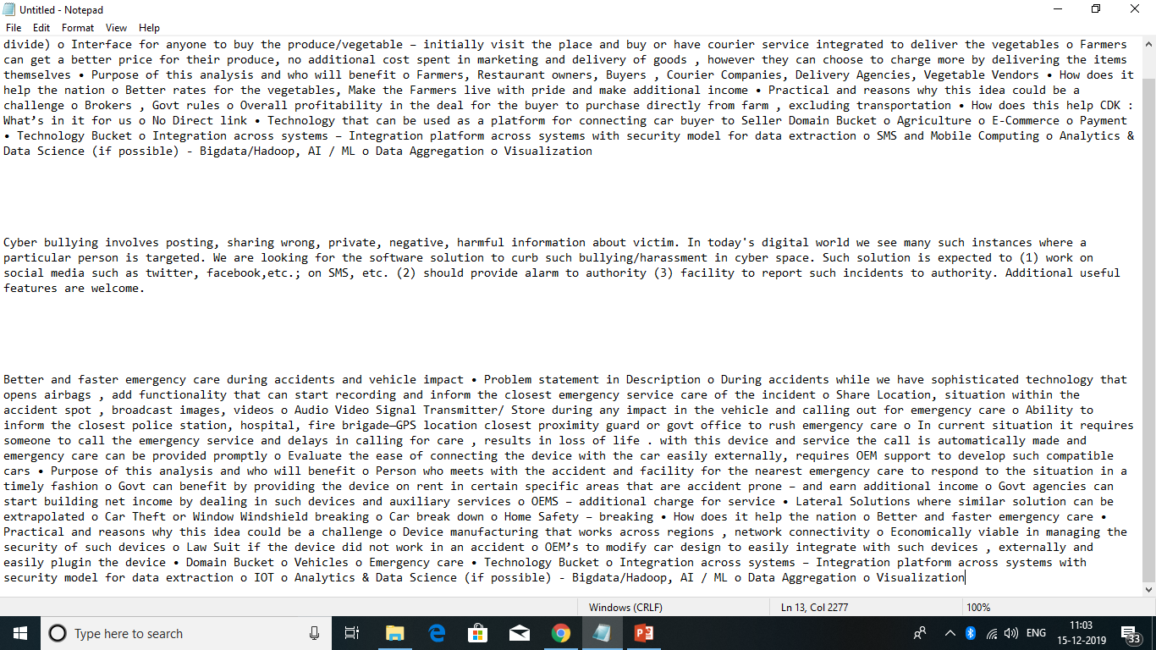
PROBLEM STATEMENT

